Slide 1
Making career choices and AI based counselling accessible to every child at secondary level along with aptitude tests and detailed career paths.
PIP4004 University Project
Final Review
Batch Number: CDV-G07
Under the Supervision of,
Ms. Ashishika Singh
Assistant Professor, School of Computer Science and Engineering
Presidency University
Roll Number | Student Name
20211CDV0012 | Nishad Babu Sulikeri
20211CDV0029 | Dinesh Kumar Reddy M
20211CDV0004 | Manishimha G
Name of the Program: B.Tech – Computer Science and Technology (DevOps)
Name of the HoD: Dr. S Pravinth Raj
Name of the Program Project Coordinator: Suma N G
Name of the School Project Coordinators: Dr. Sampath A K / Dr. Abdul Khadar A / Mr. Md Ziaur Rahman

Slide 2
Introduction
Career counseling plays a vital role in shaping students' futures, yet traditional counseling methods are often limited in availability and effectiveness. Many students lack proper guidance, leading to confusion and misinformed decisions. This project provides a solution that leverages aptitude tests, career information, and chatbot assistance to help students explore and decide on suitable career paths. The system is designed using HTML, CSS, and JavaScript, ensuring a user-friendly interface and efficient performance.

Slide 3
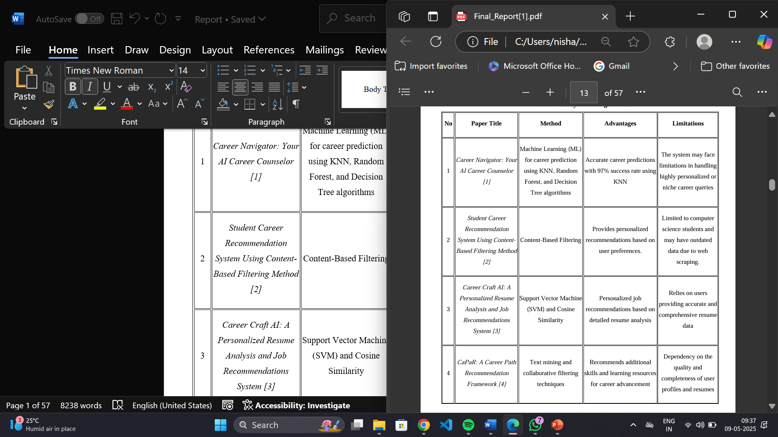
Literature Review

Slide 4

Literature Review

Slide 5
RESEARCH GAPS OF EXISTING METHODS
Lack of Stream-Specific Career Guidance for School Students
No Dedicated Career Awareness Section
Lack of User Anonymity and Privacy
No Real-Time Feedback or Interactivity
No Alternate Suggestions for Unpreferred Careers
Limited Coverage of Emerging and Non-Traditional Careers
Static Recommendation Logic (No AI or Adaptive Algorithms)
Limited Personalization Beyond Aptitude Scores
Inadequate Real-Time Interaction Capabilities

Slide 6
Proposed Method
Design and implement a web-based platform using HTML, CSS, and JavaScript.
Develop an aptitude test module to evaluate students’ skills and interests.
Use predefined career mapping logic to generate recommendations based on test scores.
Create an "Explore Careers" section with extensive career information.
Implement an AI-powered chatbot for further career-related queries and alternative suggestions.

Slide 7
Objectives
Develop an interactive AI-based career counseling system.
Implement aptitude tests to assess students' capabilities.
Provide career recommendations based on test results.
Offer detailed insights into recommended careers.
Enable users to explore different career options.
Integrate an AI chatbot for personalized guidance.

Slide 8
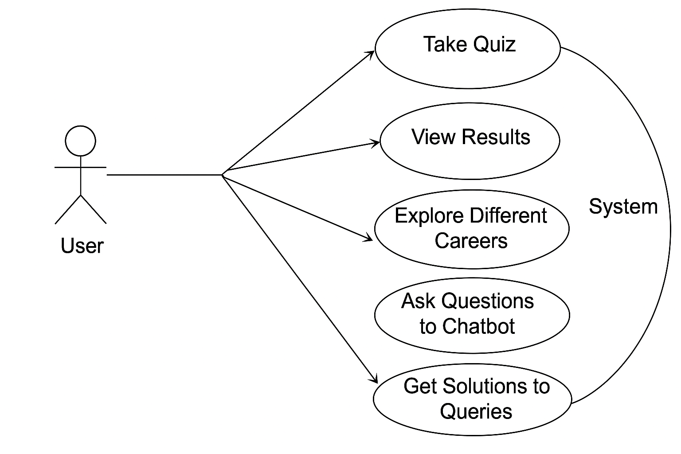
SYSTEM DESIGN & IMPLEMENTATION

Slide 9
SYSTEM DESIGN & IMPLEMENTATION
Design and implement a web-based platform using HTML, CSS, and JavaScript
Develop an aptitude test module to evaluate students’ skills and interests
Use predefined career mapping logic to generate recommendations based on test scores
Create an "Explore Careers" section with extensive career information
Implement an AI-powered chatbot for further career-related queries and alternative suggestions

Slide 10
Hardware/software components
Hardware:
Standard desktop or laptop, server for hosting the website.
Software:
Frontend: HTML, CSS, JavaScript
Backend: JavaScript
Database: BotPress cloud database(if data storage is needed)
AI Integration: NLP-based chatbot using BotPress

Slide 11
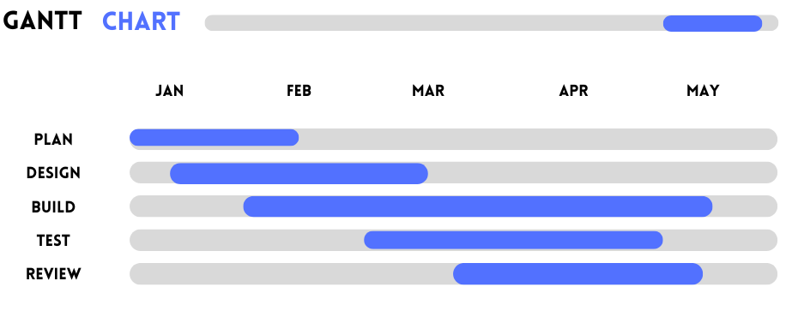
Timeline of Project

Slide 12
Expected Outcomes
Personalized Career Recommendations
The system will provide individualized career guidance by analyzing student inputs from the aptitude test (covering logical reasoning, numerical skills, verbal ability, etc.). Based on these results, students will receive customized career suggestions that align with their strengths, making the guidance more relevant and effective than generic advice.
2. Comprehensive Career Exploration
The "Explore Careers" section will give students the opportunity to learn about various career paths in-depth. This will enable students to understand the landscape of different professions and make informed decisions based on their interests and aspirations.
3. Real-time AI-powered Career Guidance
The AI chatbot will serve as an interactive tool that can provide real-time responses to career-related queries. The chatbot will offer immediate assistance and may also suggest alternative career paths if a student is unsure or wants to explore different options. By simulating human-like conversation, the chatbot will make the counselling experience feel more engaging and interactive.
4. Improved Accessibility
The web-based platform will ensure that career counselling is available to students across geographical boundaries, making it accessible to individuals from remote or underserved areas.
Traditional career counselling is often limited by location, time, and financial constraints, but this platform can be accessed 24/7 from any device with an internet connection, ensuring students don’t miss out on valuable guidance.

Slide 13
Conclusion
The AI-driven career counseling system provides personalized career guidance through aptitude tests, an "Explore Careers" section, and a chatbot for real-time support. It helps students understand their strengths, explore different career options, and receive tailored recommendations. By making career counseling more accessible and interactive, this system ensures students can make informed career choices with confidence.
Ultimately, this platform aims to empower students with the knowledge and tools they need to make informed, confident decisions about their futures. By improving accessibility, ensuring scalability, and offering real-time, data-driven insights, this system not only addresses the shortcomings of traditional methods but also paves the way for a more efficient, inclusive, and effective career counselling solution for students worldwide.

Slide 14
References
[1] A. Barbadekar, V. Bhagwan, A. Thaploo and A. Tyagi, "Career Navigator: Your AI Career Counselor," 2024 2nd DMIHER International Conference on Artificial Intelligence in Healthcare, Education and Industry (IDICAIEI), pp. 1-6
[2] A. H. A. Rashid, M. Mohamad, S. Masrom and A. Selamat, "Student Career Recommendation System Using Content-Based Filtering Method," 2022 3rd International Conference on Artificial Intelligence and Data Sciences (AiDAS), pp. 60-65
[3] A. Rajput, A. Dubey, R. Thakur, D. Singh and U. P. Singh, "Career Craft AI: A Personalized Resume Analysis and Job Recommendations System," 2024 1st International Conference on Innovative Sustainable Technologies for Energy, Mechatronics, and Smart Systems (ISTEMS), pp. 1-6
[4] B. Patel, V. Kakuste and M. Eirinaki, "CaPaR: A Career Path Recommendation Framework," 2017 IEEE Third International Conference on Big Data Computing Service and Applications (BigDataService), pp. 23-30
[5] C. Sun, "Design and implementation of career planning system based on machine learning," 2024 IEEE 3rd International Conference on Electrical Engineering, Big Data and Algorithms (EEBDA), pp. 68-73
[6] K. Joshi et al., "AI Career Guidance Tool," 2024 International Conference on Progressive Innovations in Intelligent Systems and Data Science (ICPIDS), pp. 243-248.
[7] P. D. Devi, S. S and A. Hemavathi, "AI-Enhanced Career Guidance and Aptitude Testing for Higher Education," 2024 International Conference on System, Computation, Automation and Networking (ICSCAN), pp. 1-5.
[8] U. G. S. Guntupalli, M. L. Pandala, D. T. Veeranki and P. Kumbha, "Carrer Compass: A Career Path Recommender using Machine Learning," 2024 5th International Conference on Electronics and Sustainable Communication Systems (ICESC), pp. 1937-1941.
[9] Y. Dong, "Research on Career Counselling Platform Based on Collaborative Filtering Recommendation Algorithm," 2023 International Conference on Integrated Intelligence and Communication Systems (ICIICS), pp. 1-5.

Slide 15
Github Link
https://github.com/Nishu4403/Smart-Career-Counseling-System.git

Slide 16
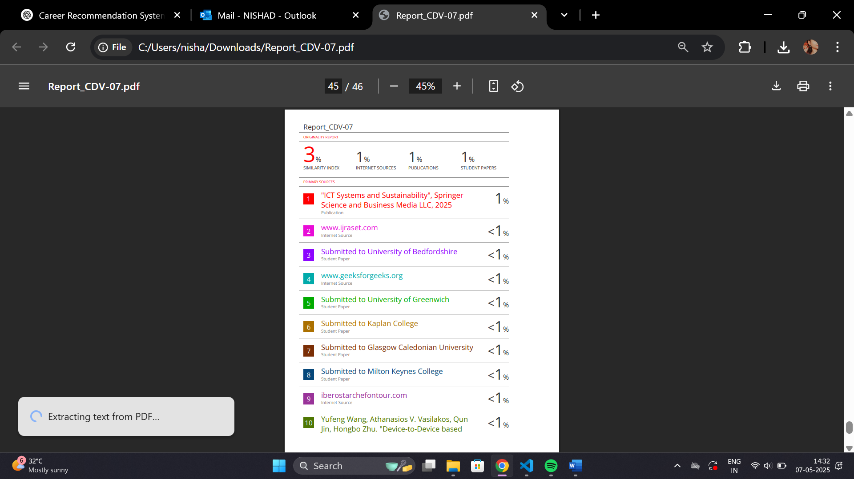
PLAGIARISM CHECK REPORT:

Slide 17
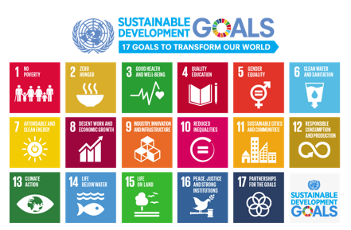
SDG MAPPINGS:

Slide 18
SDG MAPPINGS:
This project is mapped to SDG-4, SDG-8, and SDG-9.
SDG 4: Quality Education
Increase the number of youth and adults who have relevant skills for employment, decent jobs,
and entrepreneurship.
• Helping students make informed career choices early.
• Offering personalized guidance regardless of socioeconomic background.
• Promoting equal access to career counseling via digital platforms.
SDG 8: Decent Work and Economic Growth
Reduce the proportion of youth not in employment, education, or training.
• Encouraging early planning for future careers.
• Reducing career mismatch by aligning interests with viable fields.
• Empowering students to pursue career paths with long-term growth.
SDG 9: Industry, Innovation, and Infrastructure
Enhance scientific research, upgrade technological capabilities...
• Applying AI and chatbot technology in an educational context.
• Innovating an accessible, lightweight tech infrastructure for career guidance

Slide 19
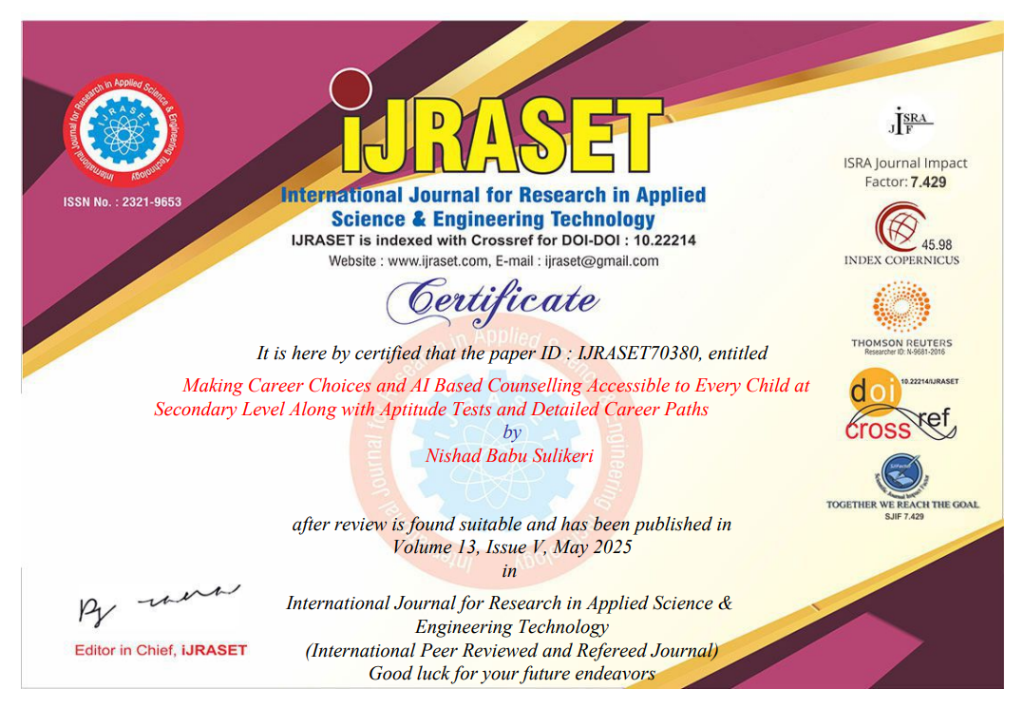
Publication Certificate:

Slide 20
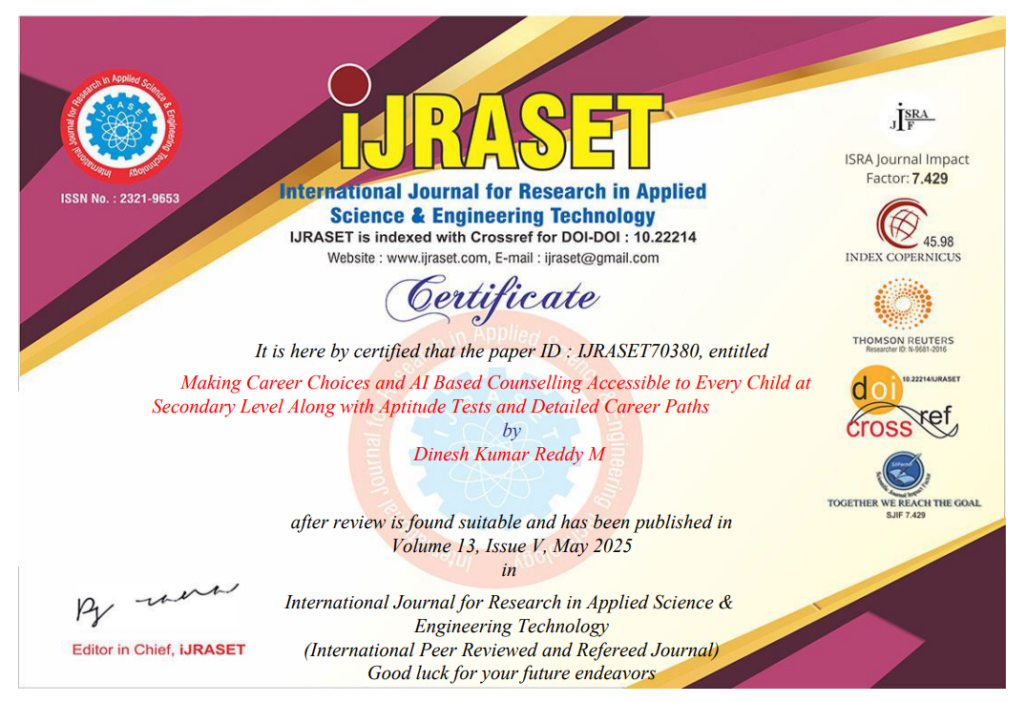
Publication Certificate:

Slide 21
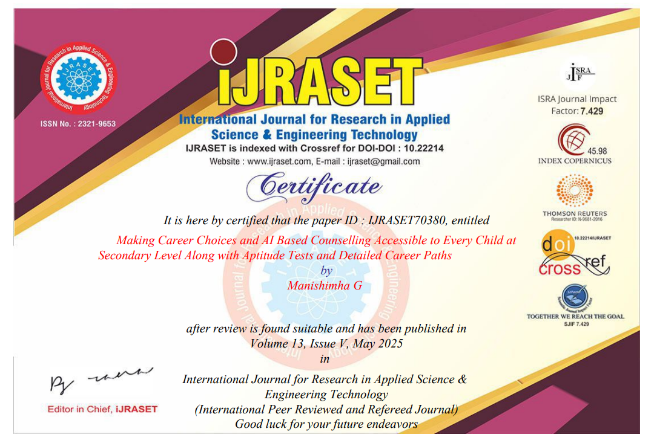
Publication Certificate:

